Slide 1
Capstone Project - 3 Bank marketing effectiveness prediction Team Members Ganeshkumar Patel Akanksha Agarwal Saurabh Funde Sanjay Kumar Yaman Saini Data Science Trainee, AlmaBetter, Bangalore

Slide 2
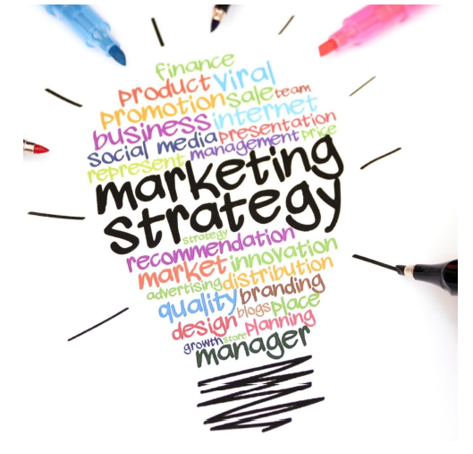
Contents:
1. Problem Statement 2. Data Exploration 3. Exploratory Data Analysis (EDA) 4. Feature Engineering 5. Feature Selection
6. Handling imbalance
7. Model building
8. Conclusions

Slide 3
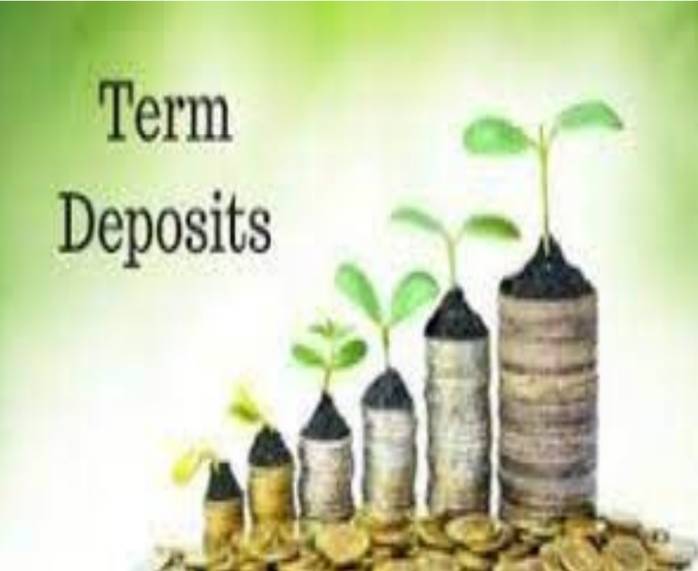
Problem Statement
▪ Aim:- Predicting the effectiveness of bank
marketing campaigns
▪ Problem Statement: The data is related with
direct marketing campaigns of a Portuguese
banking institution. The marketing campaigns
were based on phone calls. Often, more than one
contact to the same client was required, in order
to access if the product (bank term deposit)
would be ('yes') or not ('no') subscribed.The
classification goal is to predict if the client will
subscribe a term deposit (variable ‘y’).

Slide 4
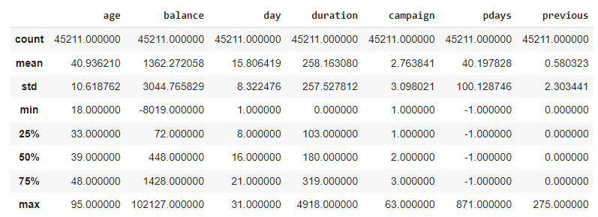
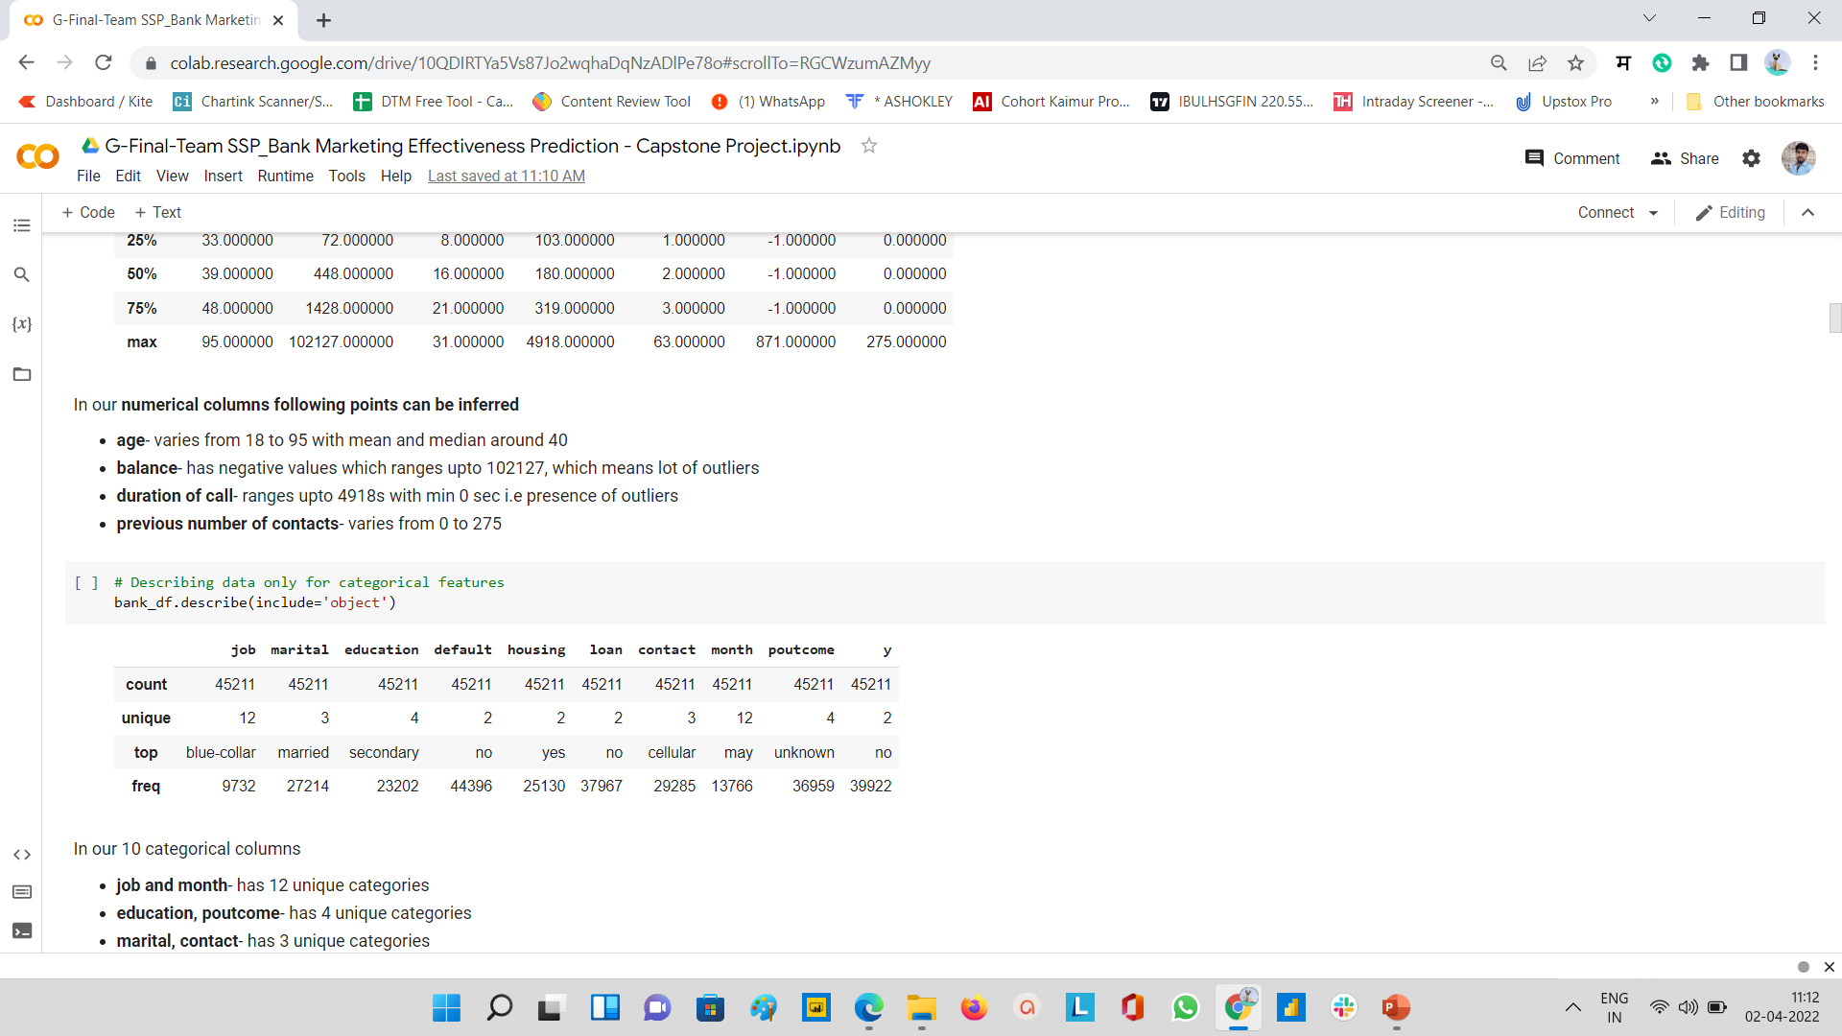
Data Summary
Categorical Features
▪ Marital - (Married , Single , Divorced)
▪ Job-(Management,BlueCollar,retired etc)
▪ Contact - (Telephone,Cellular,Unknown)
▪ Education (Primary,Secondary,Tertiary)
▪ Month-(Jan,Feb,Mar,Apr,May etc)
▪ Poutcome - (Success,Failure,Other,Unknown)
▪ Housing - (Yes/No)
▪ Loan - (Yes/No)
▪ Default - (Yes/No)
● Numerical Features
▪ Age
▪ Balance
▪ Day
▪ Duration
▪ Campaign
▪ Pdays

Slide 5
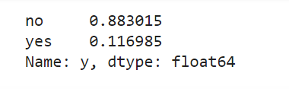
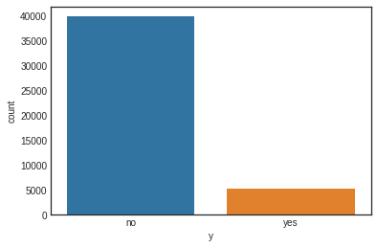
Exploratory Data Analysis 1. How many people subscribed the Term deposit?
The target variable ‘y’ tells us the outcome of the campaign whether they went ahead for the term deposit or not.
• Out of 100% only 11.70% people subscribed to the term deposit.

Slide 6
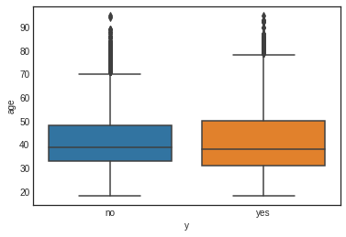
EDA(continued)
1. Age
Take away:
In the above plot it is clear that a majority of customers called is in the age of 30s and 40s (33 to 48 years old fall within the 25th to 75th percentiles) and for each of the target variable the age feauture is not linearly seperable.Thus age will be of less importance to us.

Slide 7
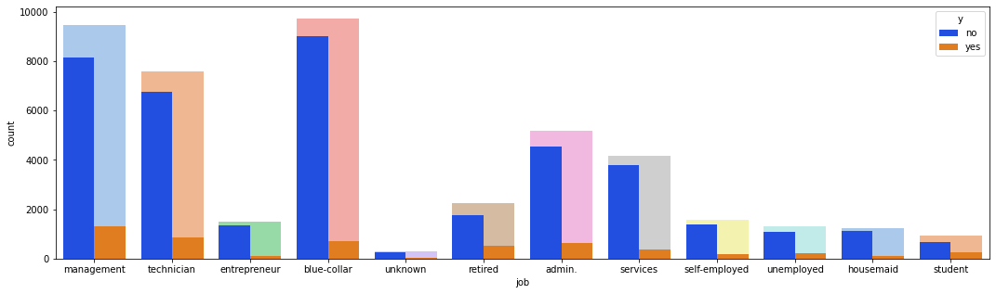
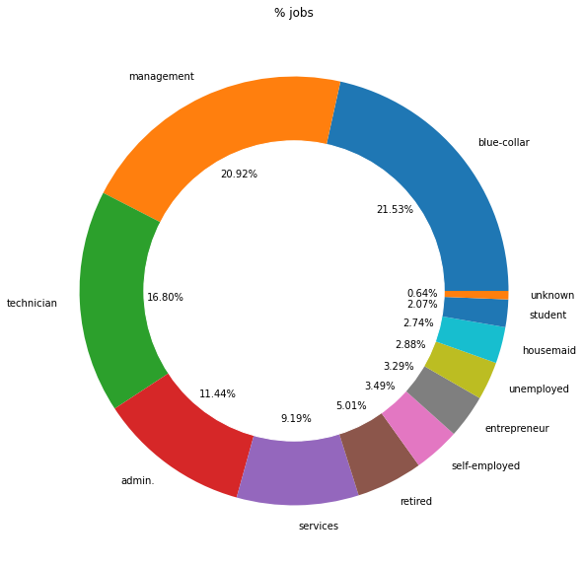
EDA(continued)
2. Job
Take away:
Customers with Blue-collar, management and technician showed maximum interest in subscription. We can also observe the large variance in our data among all categories.

Slide 8
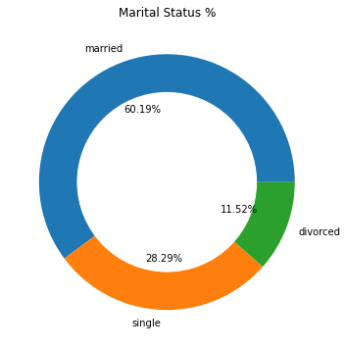
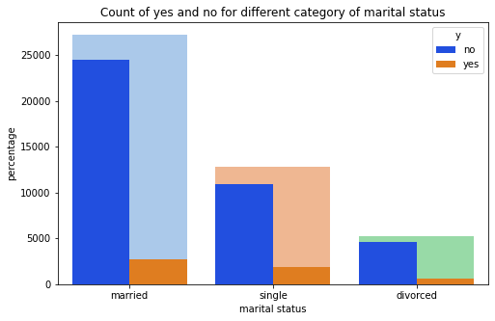
EDA(continued)
2. Marital
Take away:
Married and single showed more interest in term deposit

Slide 9
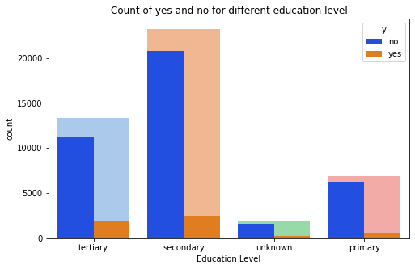
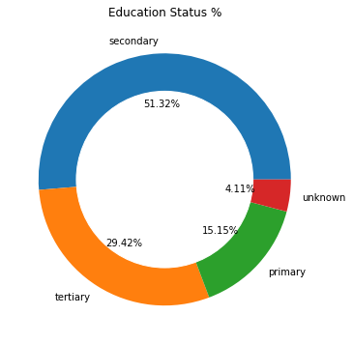
EDA(continued)
3. Education
Take away:
In comparison to primary and some unknown education, people with secondary and tertiary education were more driven towards paying term deposit in bank.

Slide 10
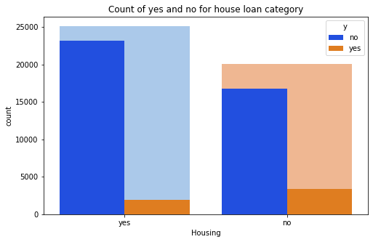
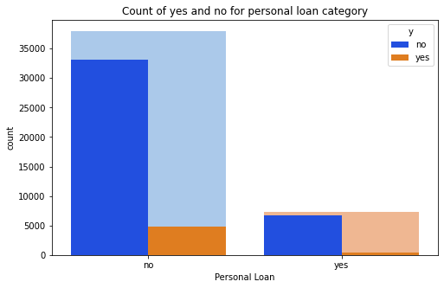
EDA(continued)
3. Loans
Take away:
Majority of the people had previous housing loans and thus very few of them opted for term deposit.
Take away:
Majority of the people had personal loans and thus very few of them opted for term deposit.

Slide 11
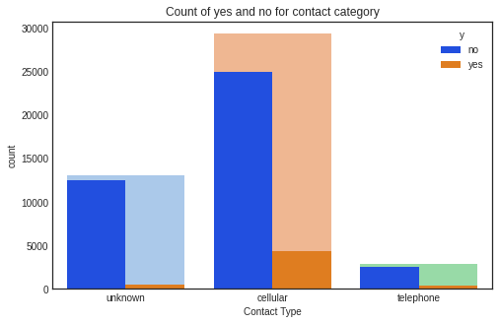
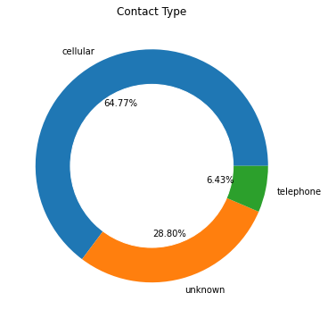
EDA(continued)
4. Contact
Take away:
Majority of the people were contacted through cellular medium and were converted to the subscription. Thus, cellular medium of contact is more effective in comparison to telephone and other mediums.

Slide 12
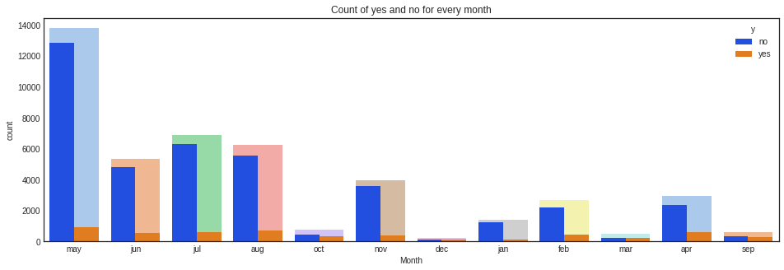
EDA(continued)
5. Month
Take away:
During the month of may there were maximum subscriptions with relatively good subscriptions in June, July and august. During other months we can se less subscription and so we can combine few of them attar on

Slide 13
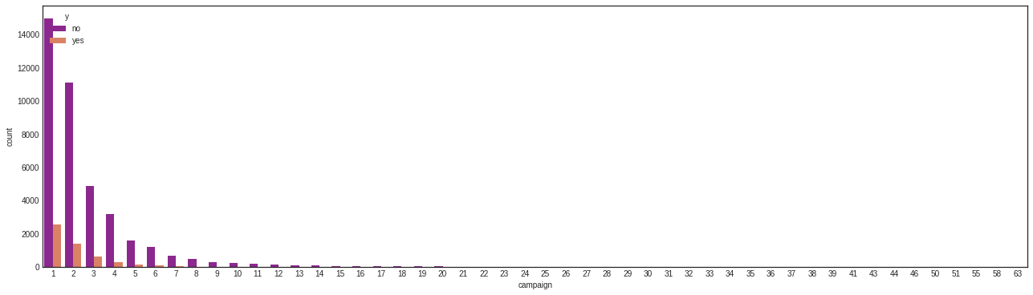
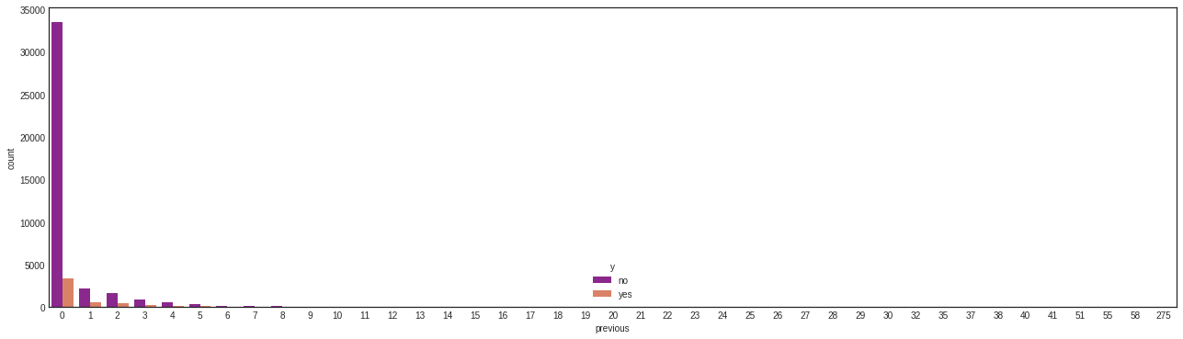
EDA(continued)
Take away:
People were mostly contacted once who subscribed to it, while others were contacted more number of times but the conversion rate reduced after 20 we did not see any significant conversions thus we drop those observations later on
6. Campaign
7. Previous
Take away:
We can see above that majority of people were not contacted previously before this campaign and there are no significant contacts after 11 times already done.

Slide 14
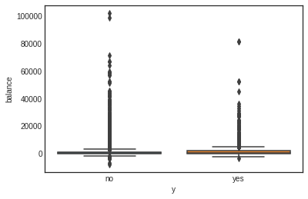
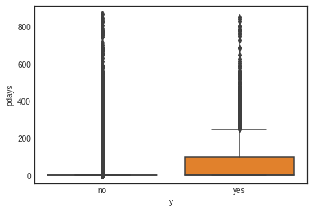
EDA(continued)
9. Pdays
8. Balance
Take away:
Balance of customers is more than 1 lacs and thus we need to remove ouliers as the median is very less near to 450.
Take away:
pdays have large outliers and will have to look upon more closely.

Slide 15
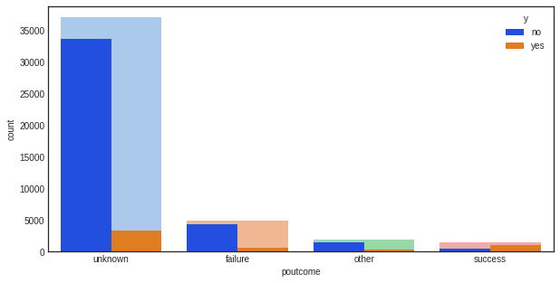
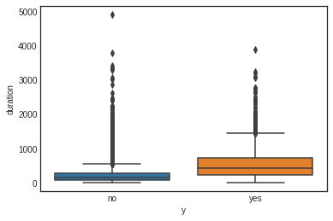
EDA(continued)
Poutcome
Duration
Take away:
Looking at poutcome we can infer that the success rate was high for some unknown category.
Take away:
The above box plot shows that calls with large duration has more tendency for conversion..

Slide 16
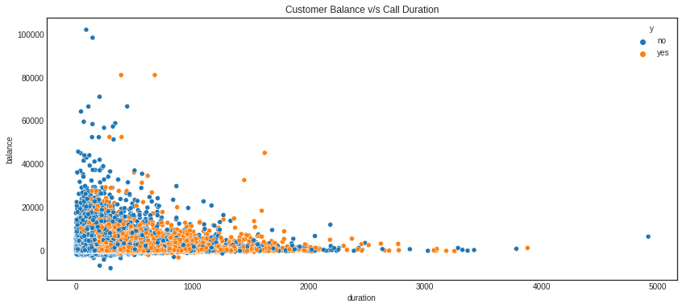
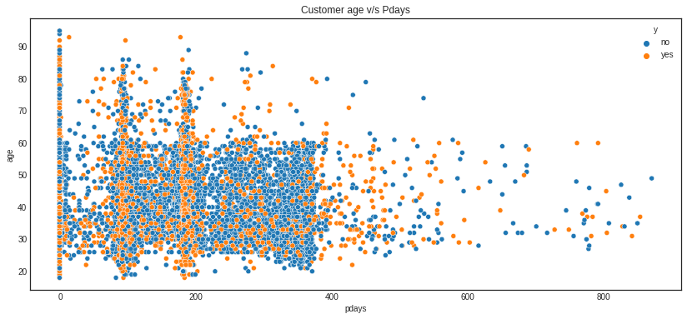
EDA(continued)
Increase in duration leads to more term deposit.
We are seeing some pattern of more term with pdays

Slide 17
Featuring Engineering
As per Exploratory Data Analysis EDA
- no missing value found
- no feature found with one value
- 9 categorical features
- not found any significant linear relationship amongst predictors
- it seems some outliers found (age, balance, duration, campaign, pdays and previous has some
outliers)
Reducing JOB categories
- admin+services = adms
- enterpenure + selfemployed + unemployed + unknown + housemade = others
- retired + student = rstd

Slide 18
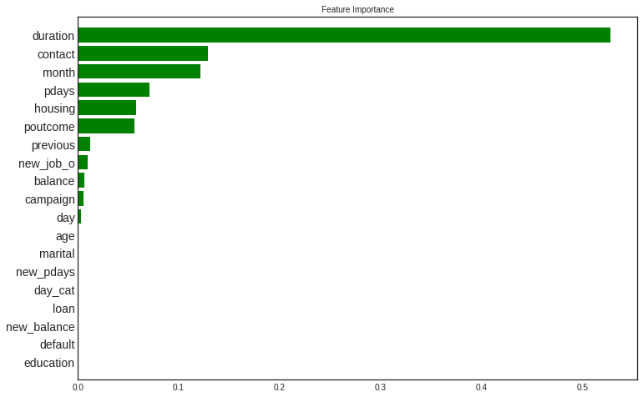
Feature importance for feature selection
Take away:
Using decision tree model we are getting these important features.
Better to go with important features only to make model robust

Slide 19
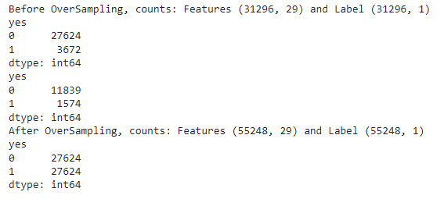
Handling Imbalance data Using SMOTE
SMOTE library used to generate synthetic data for handling the imbalance in the dataset
Purpose: to minimize the bias of model towards the class which has higher percent count in our dataset.

Slide 20
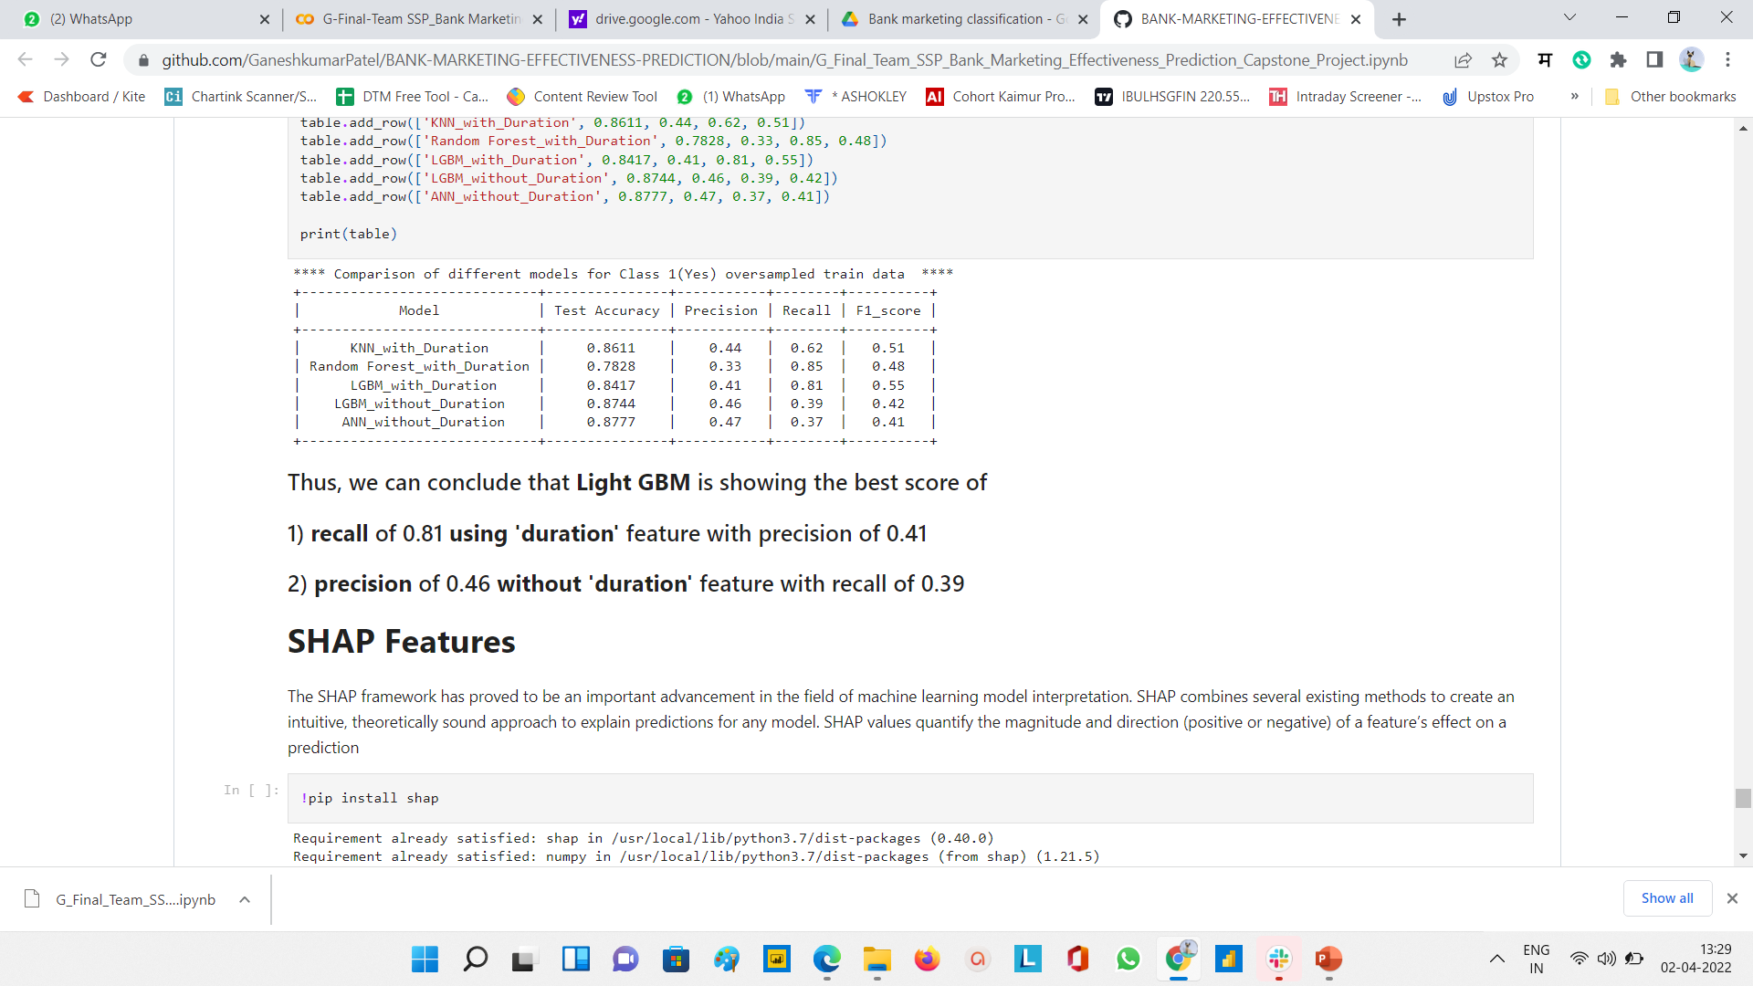
Model building
With duration columns:
1. KNN( K Nearest Neighbours)
2. Random Forest
3. Light GBM
Without duration columns:
1. Light GBM
2. ANN(Artificial Neural Nets)

Slide 21
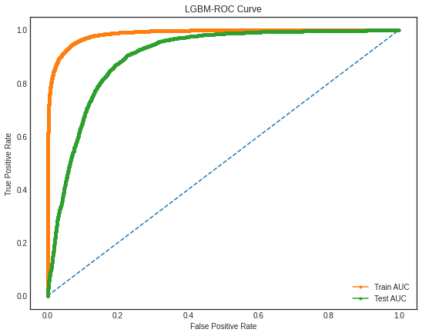
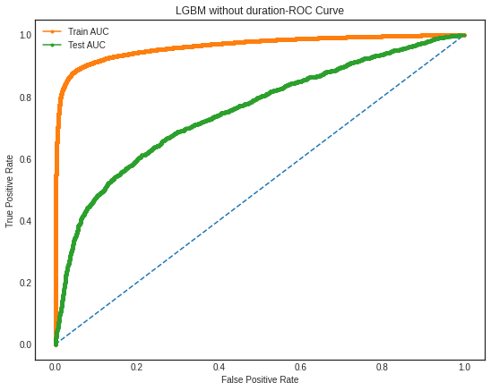
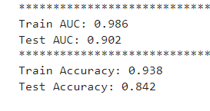
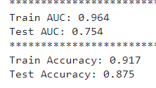
AUC ROC plot for both selected models
With duration LightGBM
Without duration LightGBM

Slide 22
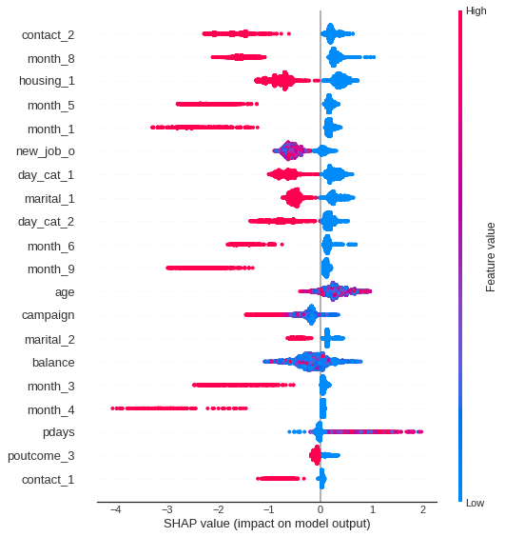
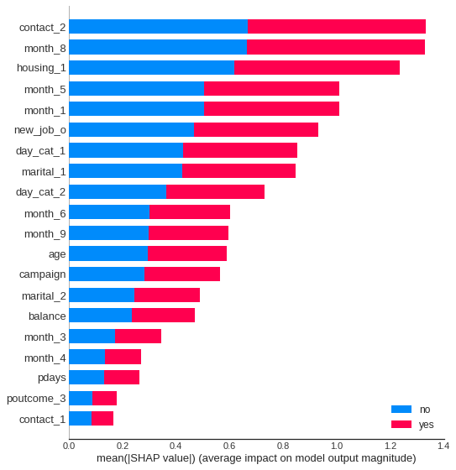
SHAP Summary Plot

Slide 23
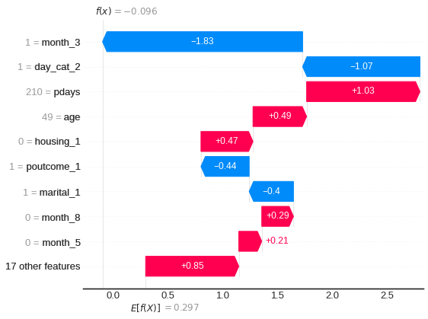
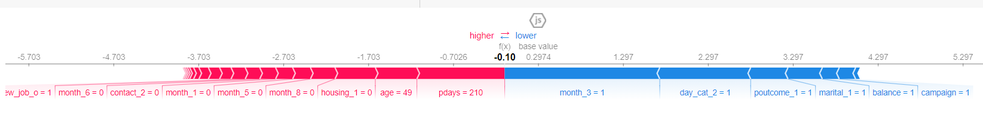
Water Plot
SHAP Individual(record explanation) Plot
Force Plot

Slide 24
Conclusion:
Thus we come to an end of our analysis and model building to predict if the client will subscribe a term deposit or not. The most important takeaways are:
If the clients are contacted twice in first 10 days of the month, then it is more likely that call will be converted to subscription.
Clients take more subscriptions in a month of January, May or August.
If clients are already paying housing loans, then it is more likely that they will opt for term deposit.
In our dataset we were provided with call 'duration' but in real world practice that won't be the case. So, to build more realistic model we trained our models for both the cases i.e with or without 'duration'. For both the cases LGBM showed best scores of recall with 'duration' and precision without 'duration'.

Slide 25
Future Scope-
Our main objective is to get good precision score for without 'duration' models and good recall score for 'duration' included model.
So, we can initially formulate the required time to converge a lead using 'duration' included models and then sort out precise leads for 'duration' excluded models using this formulated time.
Here, the idea is to find out responses for any particular record with varying assumed predefined duration range.
For example let's say, to converge a call, duration ranges between 60 to 2000 sec, then using this range we can predict all responses for each lead while iterating through this duration range. If we get positive response for any value of 'duration' we can assign that duration time to that particular lead.
In this way we can help marketing team to get precise leads along with time required to converge that lead and also, those leads that have least proability to converge (if we get no positive response for any assumed duration). Thus, an effective marketing campaign can be executed with maximum leads converging to term deposit.

Slide 26
Thank you

